Slide 1
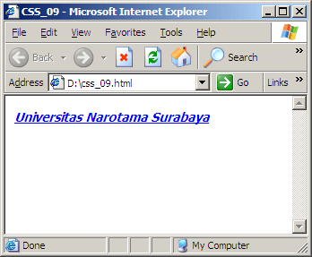
CSS (Cascading Style Sheet)
Text
<html>
<head>
<title>CSS_09</title>
<style type=text/css>
i { color:blue;
text-decoration:underline;
font-family:Tahoma;
font-size:14px;
font-weight:bold;
}
</style>
</head>
<body>
<i>Universitas Narotama Surabaya</i>
</body>
</html>
font-weight:
normal
bold
NEXT

Slide 2
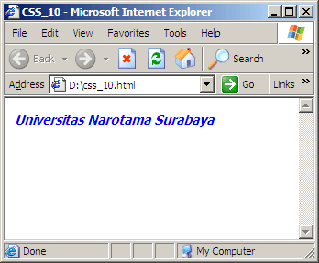
CSS (Cascading Style Sheet)
Text
<html>
<head>
<title>CSS_10</title>
<style type=text/css>
p { color:blue;
font-family:Tahoma;
font-size:14px;
font-weight:bold;
font-style:italic;
}
</style>
</head>
<body>
<p>Universitas Narotama Surabaya</p>
</body>
</html>
BACK
NEXT

Slide 3
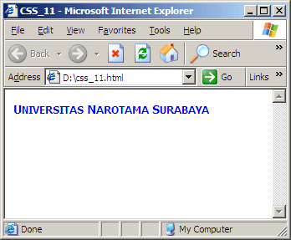
CSS (Cascading Style Sheet)
Text
<html>
<head>
<title>CSS_11</title>
<style type=text/css>
p { color:blue;
font-family:Tahoma;
font-size:14px;
font-weight:bold;
font-variant:small-caps;
}
</style>
</head>
<body>
<p>Universitas Narotama Surabaya</p>
</body>
</html>
font-variant:
small-caps (mengganti semua kar.lower-case dengan kar.upper-case)
none (tanpa efek)
Catatan: font-variant tidak berlaku pada browser Netscape
BACK
NEXT

Slide 4
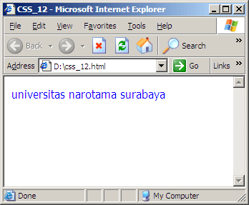
CSS (Cascading Style Sheet)
Text
<html>
<head>
<title>CSS_12</title>
<style type=text/css>
p { color:blue;
font-family:Tahoma;
text-transform:lowercase;
}
</style>
</head>
<body>
<p>UNIVERSITAS NAROTAMA SURABAYA</p>
</body>
</html>
text-transform:
capitalize (Kar.pertama huruf besar)
uppercase (Semua kar. huruf besar)
lowercase (Semua kar. Huruf kecil)
BACK
NEXT

Slide 5
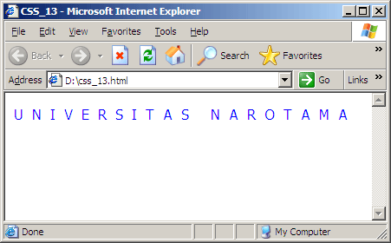
CSS (Cascading Style Sheet)
Text
<html>
<head>
<title>CSS_13</title>
<style type=text/css>
p { color:blue;
font-family:Tahoma;
letter-spacing:10px;
}
</style>
</head>
<body>
<p>UNIVERSITAS NAROTAMA</p>
</body>
</html>
letter-spacing = mengendalikan jumlah spasi antar karakter
BACK
NEXT

Slide 6
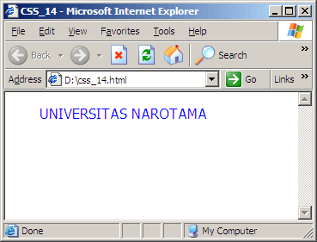
CSS (Cascading Style Sheet)
Text
<html>
<head>
<title>CSS_14</title>
<style type=text/css>
p { color:blue;
font-family:Tahoma;
text-indent:30px;
}
</style>
</head>
<body>
<p>UNIVERSITAS NAROTAMA</p>
</body>
</html>
text-indent = membuat indent untuk awal paragraf
BACK
NEXT

Slide 7
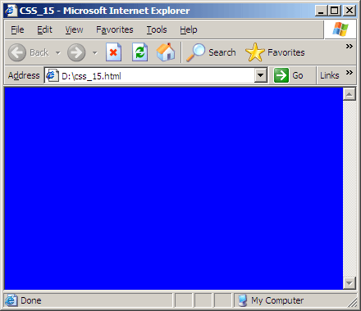
CSS (Cascading Style Sheet)
Body
<html>
<head>
<title>CSS_15</title>
<style type=text/css>
body
{
background-color:blue;
}
</style>
</head>
<body>
</body>
</html>
BACK
NEXT

Slide 8
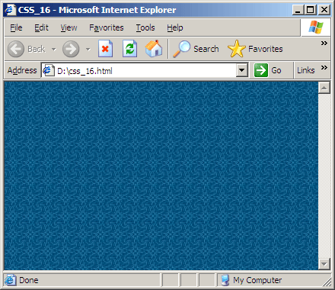
CSS (Cascading Style Sheet)
Body
<html>
<head>
<title>CSS_16</title>
<style type=text/css>
body
{ background-image: url(bg.jpg);
}
</style>
</head>
<body>
</body>
</html>
BACK
NEXT

Slide 9
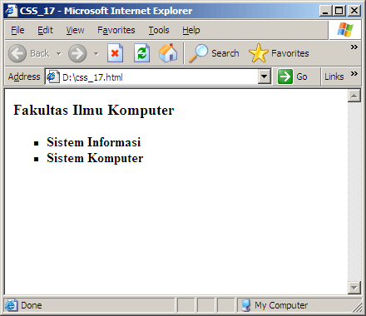
CSS (Cascading Style Sheet)
Bullet & Numbering
<html>
<head>
<title>CSS_17</title>
<style type=text/css>
li { list-style-type:square;
font-weight:bold;
}
</style>
</head>
<body>
<h3>Fakultas Ilmu Komputer</h3>
<ol>
<li>Sistem Informasi</li>
<li>Sistem Komputer</li>
</ol>
</body>
</html>
BACK
NEXT

Slide 10
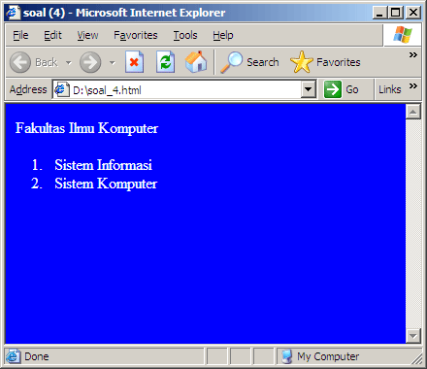
CSS (Cascading Style Sheet)
Soal (4)
Tuliskan Source Code dari tampilan berikut dengan menggunakan CSS:
PREVIEW
BACK
NEXT

Slide 11

CSS (Cascading Style Sheet)
Soal (5)
Tuliskan Source Code dari tampilan berikut dengan menggunakan CSS:
PREVIEW
BACK
NEXT

Slide 12
CSS (Cascading Style Sheet)
Catatan:
Nilai list-style-type:
disc -> efek lingkaran
circle -> efek persegi empat
square -> efek lingkaran yang transparan
decimal -> 1,2,3,…dst
lower-roman -> i,ii,iii,…dst
upper-roman -> I,II,III,…dst
lower-alpha -> a,b,c,…dst
upper-alpha -> A,B,C,…dst
None -> Tanpa Efek
BACK
NEXT

Slide 13

CSS (Cascading Style Sheet)
Soal (6)
Tuliskan Source Code dari tampilan berikut dengan menggunakan CSS:
PREVIEW
END

Slide 14
CSS (Cascading Style Sheet)
Link
Link Properties:
A:link
A:hover
A:active
NEXT

Slide 15
CSS (Cascading Style Sheet)
Link
Definisi style link:
A:link -> memberikan efek pada saat normal (unlink)
A:hover -> memberikan efek pada saat mouse pointer diatas object
A:active -> memberikan efek setelah event click
BACK
NEXT

Slide 16
CSS (Cascading Style Sheet)
Link
<html>
<head>
<title>CSS_18</title>
<style type=text/css>
a { color: #000000; /* kode warna hitam */
text-decoration: none; }
a:hover { color : #FF9900; /* kode warna orange */
text-decoration : underline; }
</style>
</head>
<body>
<a href=#>Link 1</a>
<br><br>
<a href=#>Link 2</a>
</body>
</html>
PREVIEW
BACK
NEXT

Slide 17
CSS (Cascading Style Sheet)
Link
<html>
<head>
<title>CSS_19</title>
<style type=text/css>
a { color: #000000; } /* kode warna hitam */
a:hover { color : #FF9900; } /* kode warna orange */
a:active { color: #006699; } /* kode warna biru */
</style>
</head>
<body>
<a href=#>Link 1</a><br><br>
<a href=#>Link 2</a>
</body>
</html>
PREVIEW
BACK
NEXT

